Slide 1
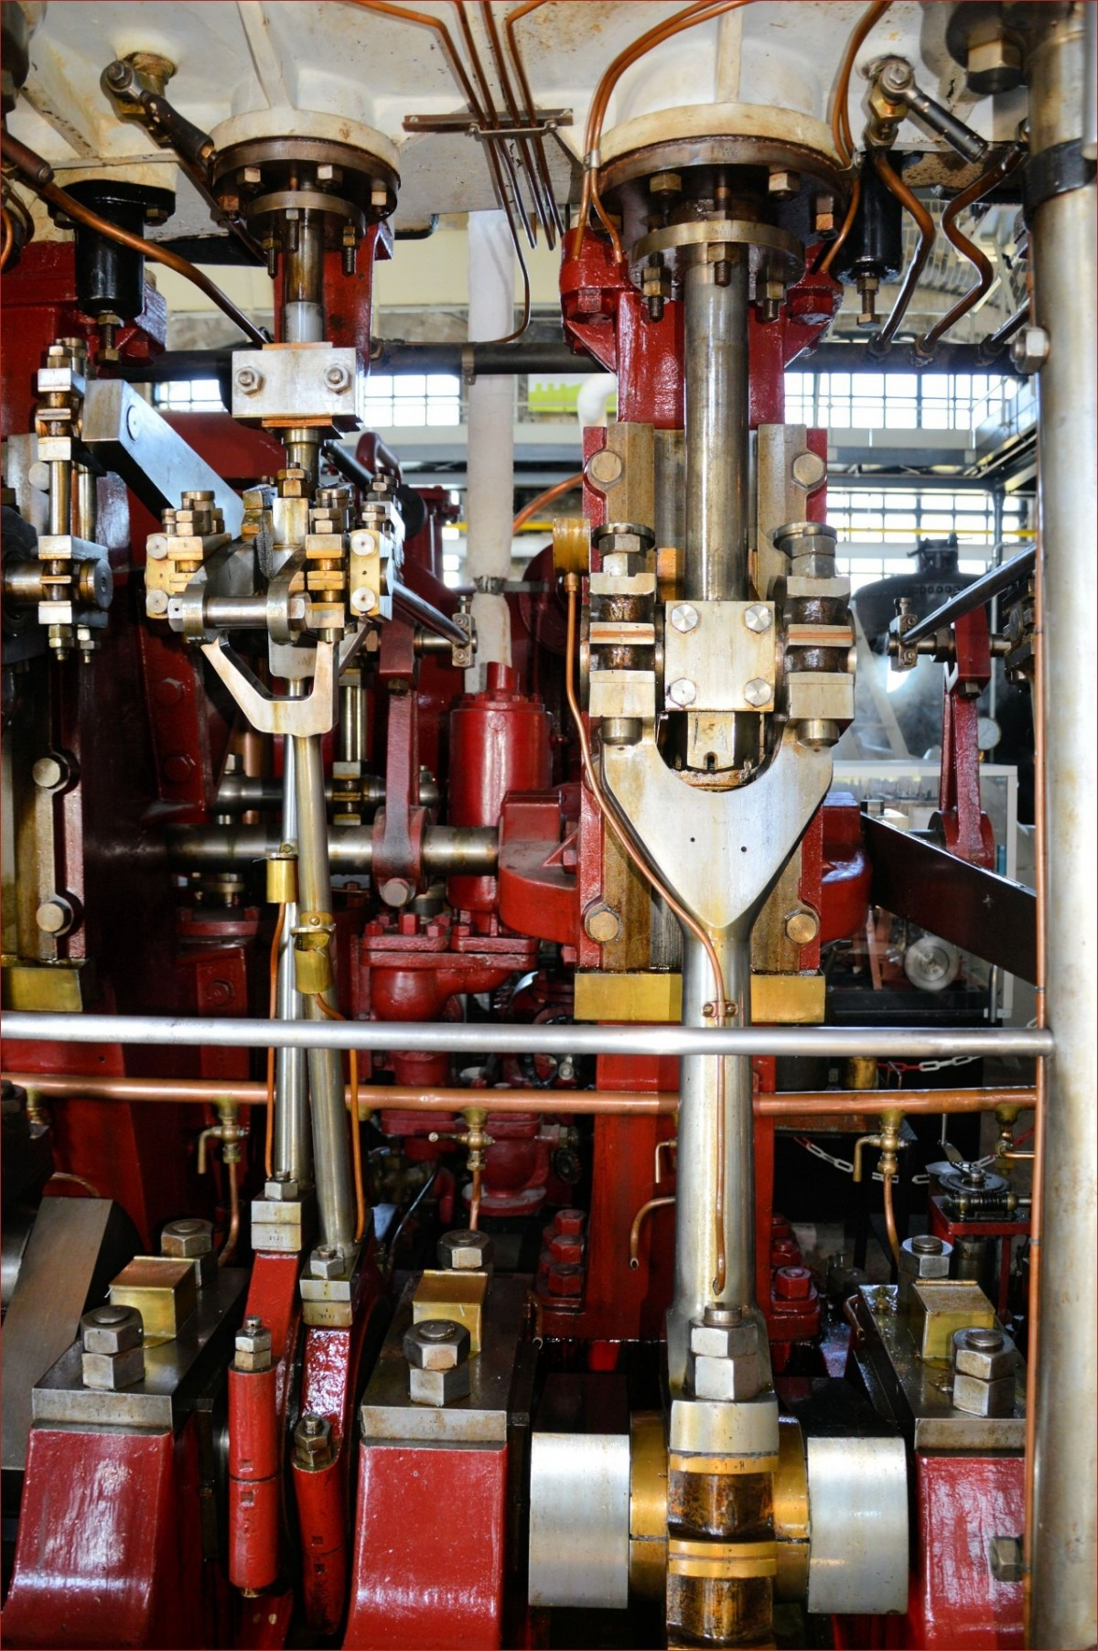
Predictive Maintenance for industrial machinery Leveraging Machine Learning to Minimize downtime
Prepared by: Guided by:
Vishnu e Entri elevate team
Date : 13/05/2024

Slide 2
Contents
Introduction
Problem Statement
Objectives
Architecture
Implementation Details
Result
Result and Analysis
Limitations
Conclusion
Future Works

Slide 3
Introduction
Predictive maintenance revolutionizes industrial operations by leveraging machine learning to minimize downtime. Traditional maintenance methods, such as preventive and reactive approaches, often prove inefficient and costly, leading to production disruptions and safety risks. In contrast, predictive maintenance anticipates equipment failures before they occur, utilizing advanced analytics and machine learning algorithms to analyze historical data, sensor readings, and operational parameters. By identifying early warning signs of equipment degradation, predictive maintenance enables timely intervention and scheduled maintenance activities, optimizing asset performance and reducing maintenance costs. This presentation explores the transformative potential of predictive maintenance in industrial settings, highlighting its benefits, challenges, and real-world applications.

Slide 4
Problem Statement
This project addresses the need for proactive maintenance strategies in industrial settings by developing a machine-learning model to predict equipment failures based on historical sensor data. By analyzing patterns in sensor readings, the model aims to forecast potential failures before they occur, enabling timely maintenance interventions. The goal is to minimize downtime, optimize resource allocation, and reduce maintenance costs by transitioning from reactive to proactive maintenance practices. Through this approach, manufacturing plants can improve operational efficiency, maximize equipment uptime, and enhance overall productivity.

Slide 5
Objectives
Development of a robust predictive maintenance model leveraging machine learning techniques.
Reduction in unplanned downtime through proactive maintenance interventions.
Cost savings, optimized resource allocation, and enhanced productivity in industrial machinery operations.
Evaluate the performance of different models in predicting Machine failure.
Evaluate the impact of different feature selection methods on the performance of predictive maintenance models.

Slide 6
Architecture
Start
Model
Building
Feature selection
Data Fetching
Feature
Scaling
Model testing
EDA
Data Cleaning
Evaluation

Slide 7
Implementation Details

Slide 8
1. Data collection and validation
The dataset was given by the ENTRI Elevate team.
The given data has 10000 rows and 17 columns.
Data type of columns – Validating the data type of the columns if wrong, then it was corrected.
Null values in columns – Validating the column in the dataset have null values or missing information.

Slide 9
2. Data Pre-processing
Performing EDA to get insights of the data like identifying distribution, outliers etc.
Check any null values present in the dataset. If present then impute or remove those null values.
Checking for duplicate values.
Removing unnecessary columns.
Perform several visualization tools like Boxplot, Scatter plot, Count plot and Histogram.
Checking the correlation between features and target variables using correlation matrix and heatmap.
Perform Standard Scalar to scale down values.

Slide 10
3. Model selection
Choosing the appropriate machine learning model is crucial for the success of the predictive maintenance classification project. Considerations include the complexity of the data, the interpretability of the model, and computational efficiency. So models like Logistic regression, Random forest, Decision tree, SVM, MLP classifier, Gradient boosting machines, Naive Bayes and KNN (K-Nearest Neighbors) classifiers are used.

Slide 11
4. Feature Selection
Using feature selection methods like Selectkbest, Random forest classifier, SelectFromModel with Lasso (L1 Regularization), Recursive Feature Elimination (RFE) with Random Forest Classifier and Variance Threshold.

Slide 12
5. Model Training
Split 80% of the dataset into training data (used for model training) and 20% into testing data (used for model evaluation).
During training, the model learns patterns and relationships in the training data to make predictions.

Slide 13
6. Model Evaluation
Predictions: Use the trained model to make predictions on the test data (X_test).
Evaluation Metrics: Calculate performance metrics (Eg: Accuracy score, Confusion matrix, Precision score, Recall score and f1 score) to assess how well the model generalizes to unseen data.

Slide 14
Result

Slide 15
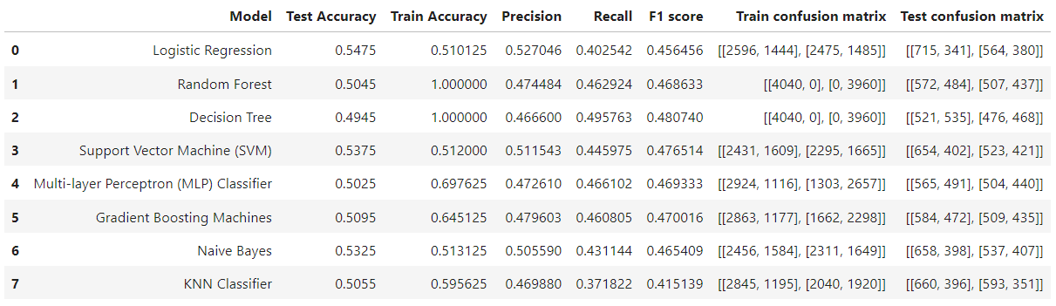
Without using Feature selection and hyperparameter tuning

Slide 16
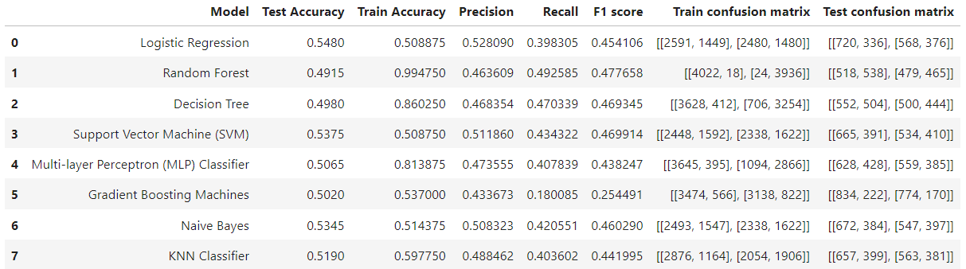
Feature Selection Using Selectkbest

Slide 17
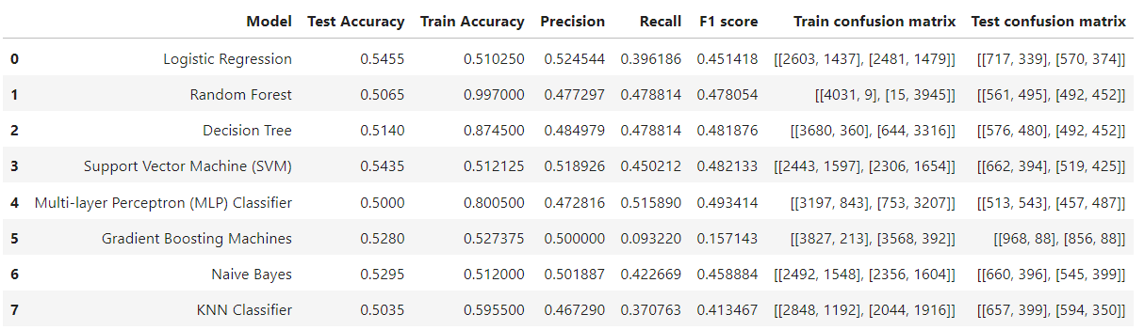
2. Feature selection using Random forest classifier

Slide 18
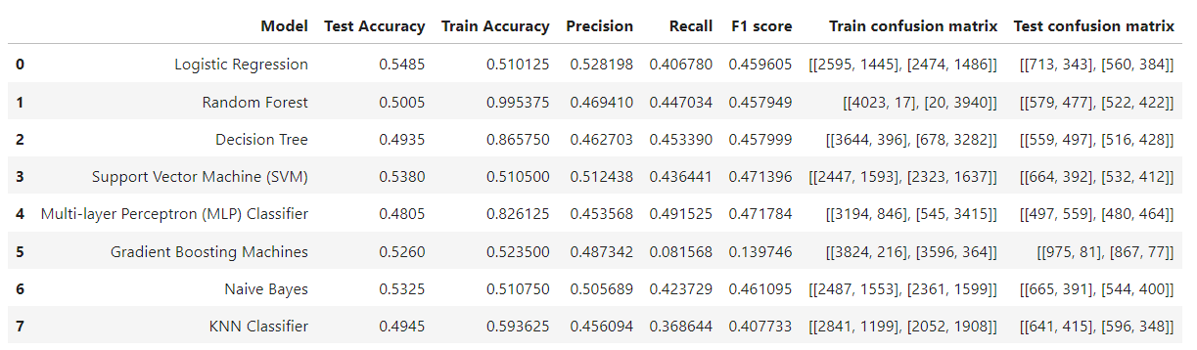
3. Feature selection using SelectFromModel with Lasso (L1 Regularization)

Slide 19
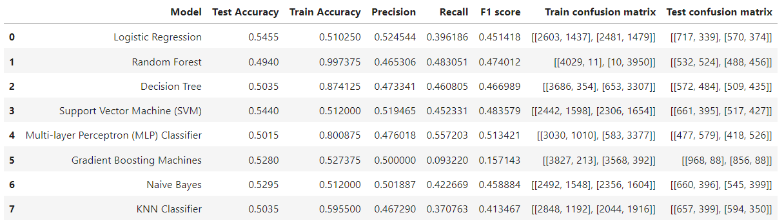
4. Feature selection using Recursive Feature Elimination (RFE) with Random Forest Classifier

Slide 20
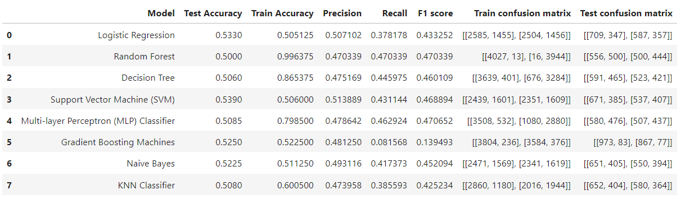
5. Feature selection using Variance Threshold

Slide 21
Result and Analysis
Without using any feature selection methods or hyperparameter tuning logistic regression gives the best accuracy score (0.5475).
Among all these feature selection techniques, SelectFromModel with Lasso (L1 Regularization) method performed well and gave Logistic regression as the best model with an accuracy of 0.5485.

Slide 22
Limitations
Despite the absence of missing values and outliers, the low correlation between features and the target variable suggests that the selected features may not adequately capture the underlying patterns or predictive signals related to equipment failures or maintenance needs.
The low correlation between features indicates that the chosen features may not fully capture the complex relationships and interactions within the dataset. This limitation could hinder the models' ability to generalize well to unseen data or accurately predict future maintenance events.
Limited discriminatory power despite using multiple feature selection methods. Model accuracy may be influenced by complexity, hyperparameter sensitivity, or overfitting.
The dataset's limited scope or representation of industrial machinery and operational conditions may also contribute to the low accuracy of the models.
External factors and context not accounted for in the dataset may introduce uncertainty in model predictions.

Slide 23
Conclusion
This project highlights the effectiveness of machine learning techniques in developing predictive maintenance systems for industrial machinery, offering a robust approach to foresee and mitigate equipment failures.
The examination of eight machine learning models that are Logistic regression, Random forest, Decision tree, SVM, MLP classifier, and Gradient boosting machines, you also used Naive Bayes and KNN (K-Nearest Neighbors) classifiers for predicting machine failure shows that Logistic regression is the best performing with an accuracy of 0.5485.
The feature selection method, SelectFromModel with Lasso (L1 Regularization), showcased promising results by identifying a subset of features conducive to logistic regression modeling. Despite this, the overall predictive performance across models remains modest, with accuracies ranging from 48.05% to 54.85%. These findings underscore the challenges posed by the dataset's limited feature representation and sparse correlations with the target variable.

Slide 24
Future Works
To enhance predictive capabilities, future efforts should focus on advanced feature engineering, leveraging domain expertise, and exploring ensemble methods. Additionally, considering external factors and conducting thorough sensitivity analyses can provide valuable insights for refining predictive maintenance strategies and improving model effectiveness in real-world scenarios.
Future work could investigate Deep learning models or advanced ensemble methods to enhance model performance. Future efforts may focus on enhancing these models to predict failures at a component level, thus offering more detailed insights into the specific maintenance needs of machines. Additionally, integrating real-time data processing could further improve model responsiveness to sudden changes in machine behavior, potentially leading to more timely and precise failure predictions. This could not only optimize maintenance schedules but also significantly extend the operational life and efficiency of industrial assets.

Slide 25
THANK YOU

